Slide 1
Eating out
UNIT 5B

Slide 2
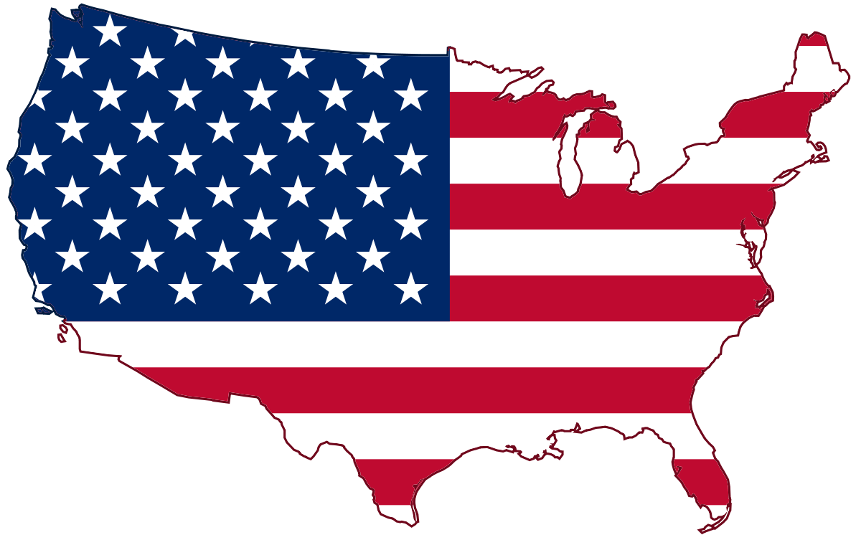
Agenda
Review: Present simple tense
Vocabulary: Food & drinks
Fruits and vegetables
Reading: Breakfast time
StopotS

Slide 3
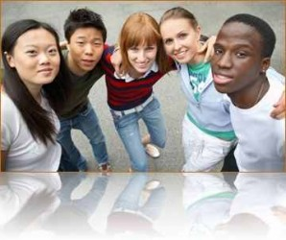
Learning objectives
The student will be able to explore more about the American and British culture.
The student will be able to learn about food and drinks in multiple settings.

Slide 4
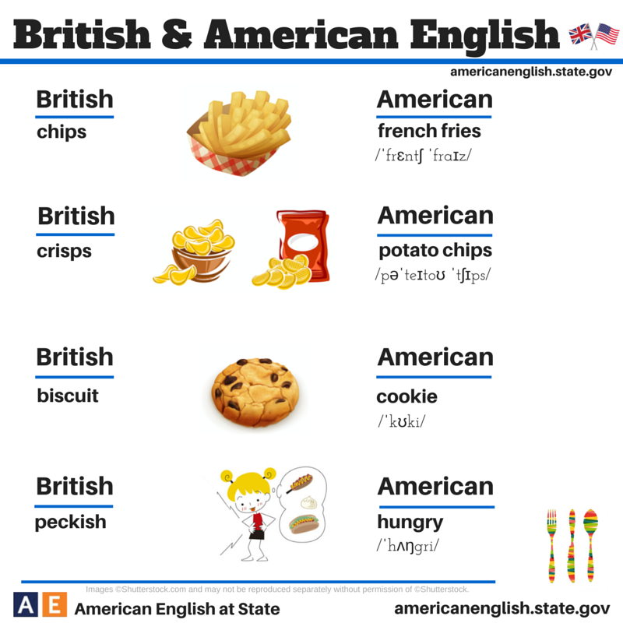
Food
What potato chips do you prefer?
Where does the French fries come from?

Slide 5
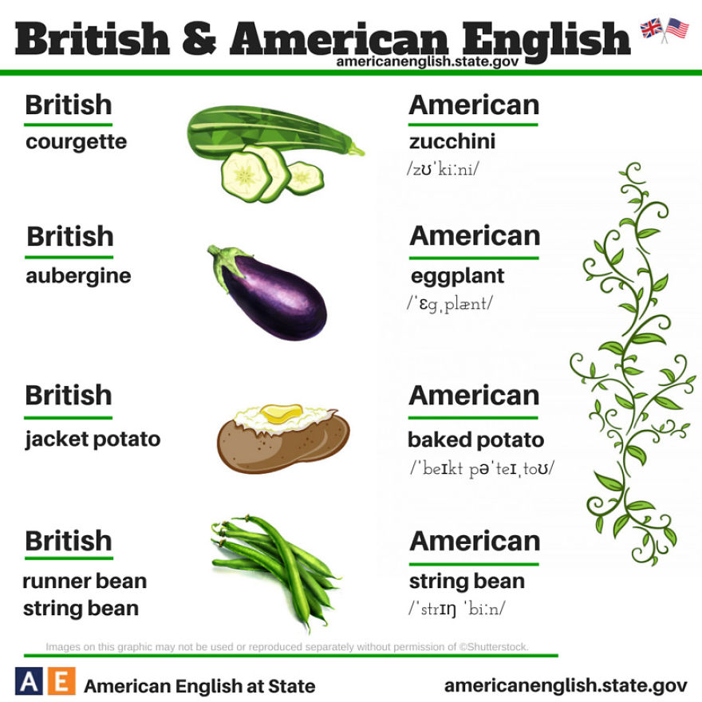
Food II
What recipe do you know with eggplants?
What’s your favorite vegetable?

Slide 6
Drinks
Beer
Juice
Milkshake
Tea
Coffee
What beer brand do you usually drink?
Which kind of coffee do you prefer, expresso or American?
What fruit juice don’t you like?

Slide 7

Gap fill
___________: long, thin pieces of potato that are fried and eaten hot. (US)
____________: a potato baked whole with its skin. (US)
_______: a small, flat cake that is dry and usually sweet. (UK)
_____: an alcoholic drink made from grain and hops.
__________: an oval, purple vegetable that is white inside and is usually eaten cooked. (UK)
French fries
Baked potato
Biscuit
Beer
Aubergine

Slide 8
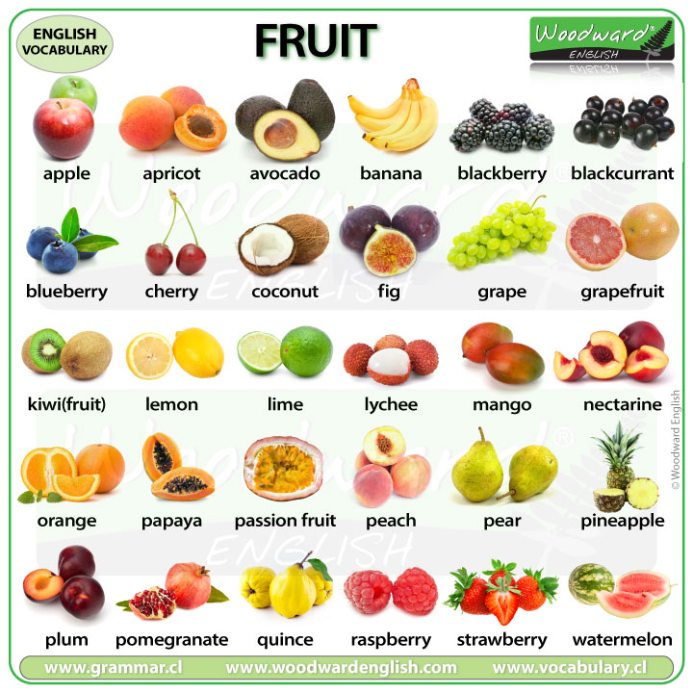
Fruits
What fruit do you love to eat?
What fruit don’t you eat often?
Where do you usually buy fresh fruits?

Slide 9
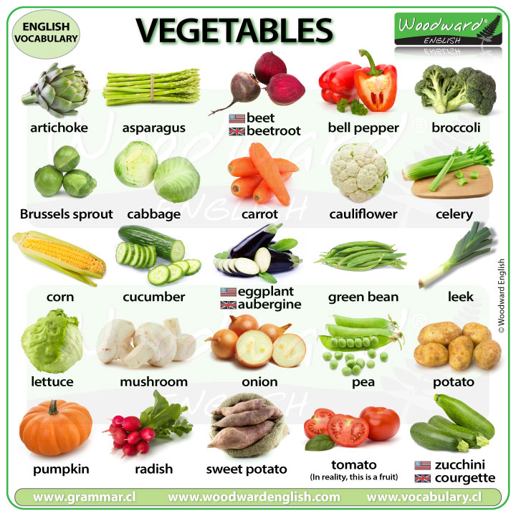
Vegetables
How often do you eat vegetables?
Would you like to be vegetarian? Why?

Slide 10
Matching exercise
Blueberry
Pineapple
Broccoli
Pumpkin
Cherry
Garlic
Fig
A small, round, soft red or black fruit with a single hard seed in the middle.
A sweet, soft, purple, or green fruit with many seeds.
The yellow fresh and juice of a large tropical fruit with a rough orange or brown skin and pointed leaves on top.
A large, round vegetable with hard, yellow or orange flesh.
The dark blue fruit of a bush that is grown in North America.
A vegetable with a green stem or stems and a mass or several masses of flower buds at the top.
A plant of the onion family that has a strong taste and smell.
StopotS ☺

Slide 11
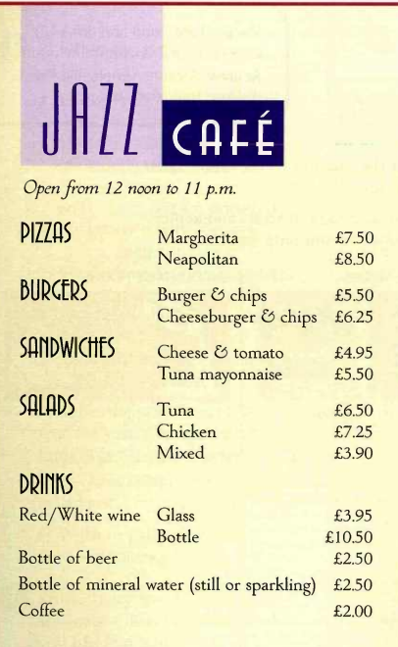

The Menu
Anything drink order red
Would you like _____ or white?
Would you like ________ else?
Would you like to _____ now?
What would you like to _____?
red
anything
order
drink

Slide 12
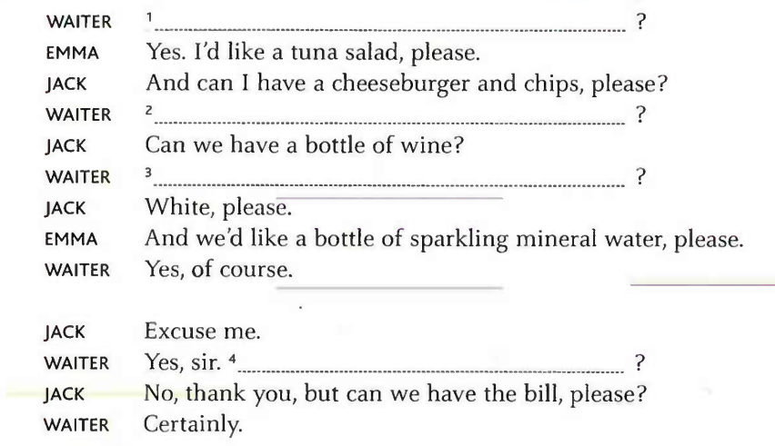
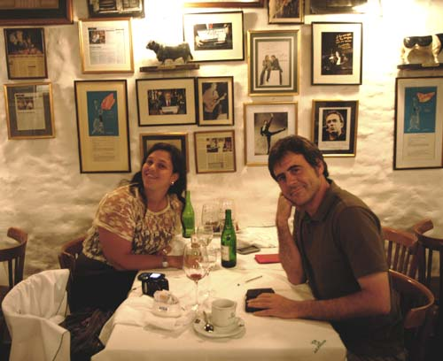
Would you like to order now
What would you like to drink
Jack and Emma’s conversation
Would you like red or white
Would you like anything else

Slide 13
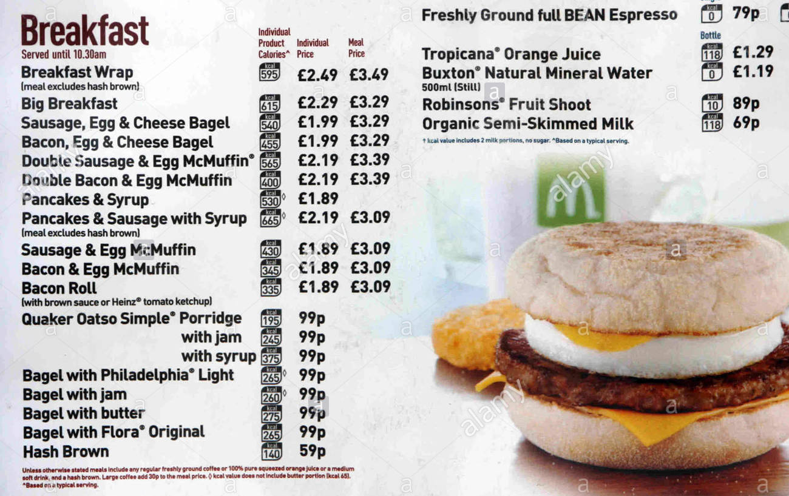
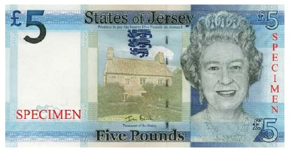
McDonald’s menu
Tip!
Pound £

Slide 14
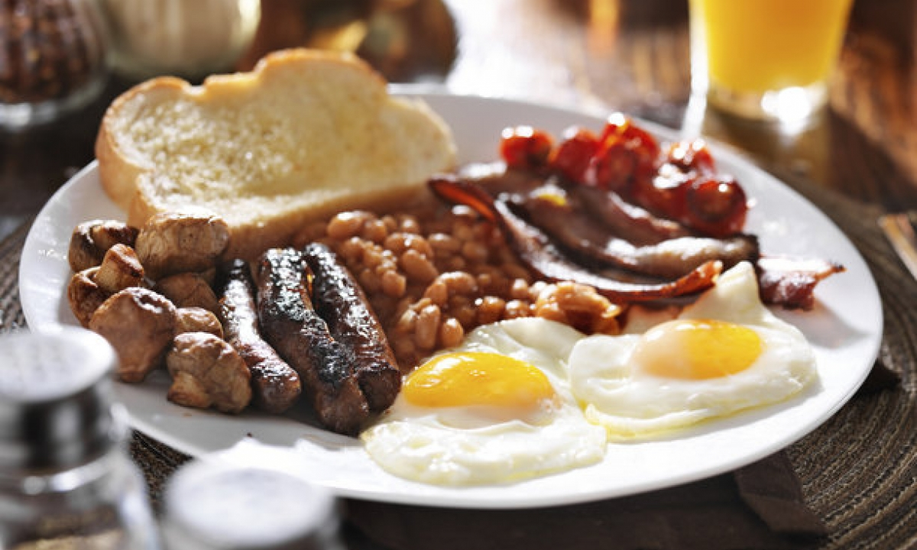
English breakfast
I'm really enjoying life in a foreign country, however there is always the odd home comfort I really miss (usually food). The other day I was craving nothing more than a good old English breakfast so I searched high and low in the French supermarket to stock up on ingredients to make one. A traditional full English breakfast, also commonly known as a fry up, consists of the following:
Eggs (either fried or scrambled)
Bacon
Sausage
Toast or fried bread
Baked beans
Hash browns
Tomato
Mushrooms

Slide 15
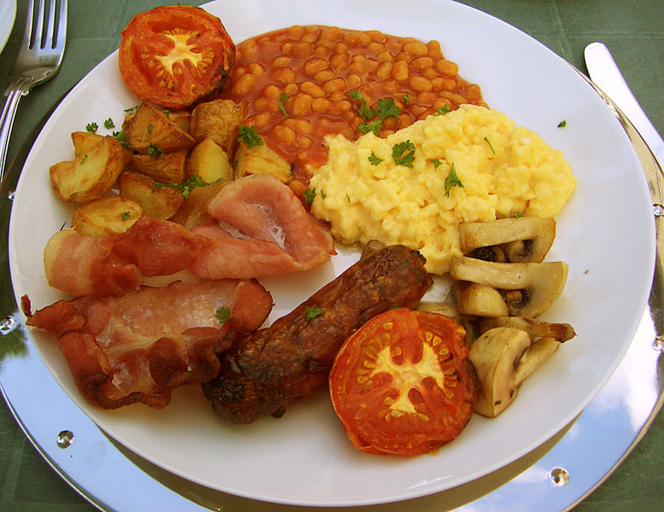
Comprehension task
What’s a fry up?
What vegetables has the English breakfast got?
What meat has it got?
Is it a healthy breakfast?
Where do you find an English restaurant in Bogota?
An English breakfast!
Tomato, mushrooms and baked beans.
Bacon and sausage.
No, it isn’t.
Chapinero

Slide 16
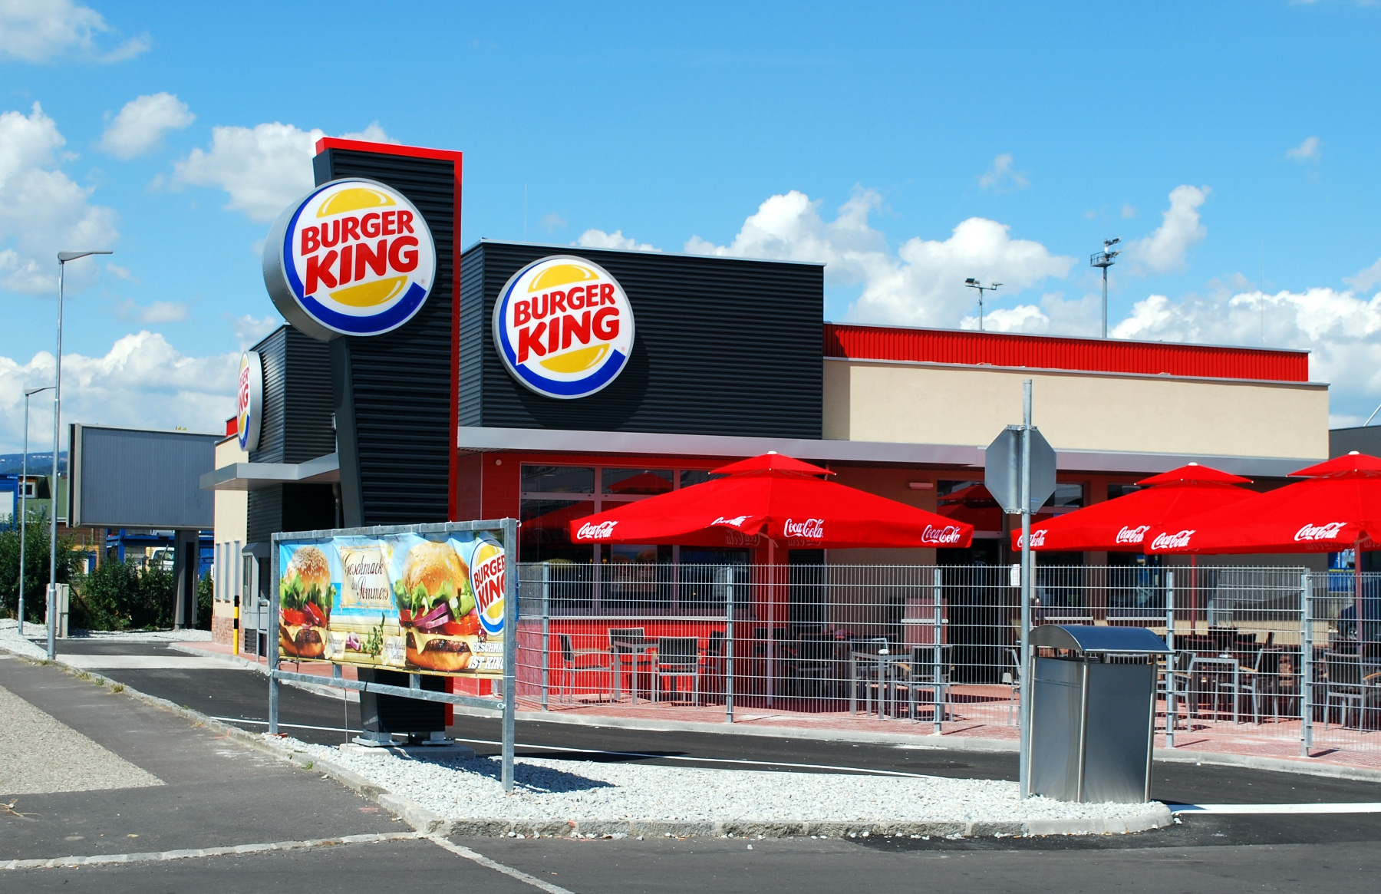
Discussion
When do you usually eat out?
What’s your favorite restaurant?
Is it cheap or expensive?
What do you usually eat there?

Slide 17
Tongue twister
Give papa a cup of proper coffee in a copper coffee cup.

Slide 18
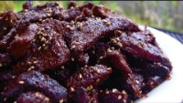
Survey:
What’s your favorite American snack?
What American snack don’t you like? Why?

Slide 19

Speaking
Reading
Sing king
https://lingua.com/english/reading/
English tips

Slide 20


